Slide 1

A Project/Dissertation/Seminar Report
PRESENTATION
ROADWATCH
Traffic Sign Recognition System Using
Machine Learning And Neural Networking
SUBMITTED BY SUPERVISED BY
MOHD KAIF KHAN MR. FARAZ DOJA
2020-310-155
BTCSE-C
SUBMITTED TO
Department of Computer Science & Engineering
School of Engineering Sciences & Technology
JAMIA HAMDARD

Slide 2
OBJECTIVE:
The aim of the “Roadwatch” is to create an effective system for automatically identifying and categorizing traffic signs from images or video feeds. By harnessing machine learning methodologies, the project endeavors to bolster road safety by promptly recognizing traffic signs, thereby aiding drivers in adhering to traffic regulations and reducing the likelihood of accidents due to human error or oversight. To address the variability of road signs across diverse regions and environments, the project will train models on varied datasets to ensure consistent performance in different conditions. Furthermore, the project seeks to assess the practical application of the system in scenarios such as autonomous vehicles, advanced driver-assistance systems (ADAS), or traffic management platforms to contribute to the advancement of intelligent transportation systems.

Slide 3
INTRODUCTION:
Road signs play a pivotal role in managing traffic by conveying essential information to drivers, pedestrians, and other road users. These signs are crafted to offer clear and concise guidance on traffic regulations, speed limits, and potential hazards. Nevertheless, variations in size, color, and shape exist across countries, regions, and cities, posing a challenge, particularly for foreign drivers, and potentially increasing the likelihood of accidents.
To mitigate this challenge, machine learning (ML) models can be leveraged to automatically detect and recognize road signs. These models assist drivers in accurately identifying road signs in real-time, thereby diminishing the risk of accidents attributed to human error. By employing computer vision techniques and deep learning algorithms, a road sign detection and recognition model can be constructed. This model undergoes training on a sizable dataset comprising road sign images and their corresponding labels. Subsequently, it is assessed on a separate set of images to gauge its accuracy and performance.
As the availability of image data and computing power continues to expand, road sign detection and recognition models are evolving into more sophisticated and precise tools. This advancement holds promise for fostering safer and more efficient road transportation systems.

Slide 4
IMPLEMENTATION:
1. Data Collection
I meticulously gathered a diverse dataset comprising images of various traffic signs from multiple sources. This dataset included publicly available datasets as well as custom collections to ensure diversity and comprehensiveness.
Emphasis was placed on collecting images covering a wide range of traffic signs, considering variations in shape, color, size, lighting conditions, and viewpoints.
2. Data Preprocessing
Preprocessing the collected images was a critical step to standardize them for effective training.
Techniques such as resizing images to a uniform size, converting them to a consistent color format (e.g., RGB), and normalizing pixel values were applied.
These preprocessing steps aimed to ensure consistency in the dataset and facilitate optimal learning by the model.
3. Model Selection
After careful consideration, I opted for a Convolutional Neural Network (CNN) as the model architecture for traffic sign detection.
CNNs have demonstrated remarkable performance in learning spatial hierarchies of features from image data, making them well-suited for tasks like traffic sign detection.
The choice of CNN was based on its ability to handle the complexities and variations present in traffic sign images.

Slide 5
IMPLEMENTATION:
4. Model Training
The dataset was split into training and validation sets to evaluate the model's performance during training.
Hyperparameters such as learning rate, batch size, and number of epochs were tuned through experimentation to optimize the model's performance.
Training involved feeding the training images into the CNN and adjusting its parameters based on prediction errors using optimization techniques like Stochastic Gradient Descent.
5. Model Evaluation
Rigorous evaluation of the trained model's performance was conducted on the validation dataset.
Standard evaluation metrics such as accuracy, precision, recall, and F1-score were computed to assess the model's effectiveness in detecting traffic signs.
Visualization techniques, including confusion matrices and sample detections, provided insights into the model's strengths and weaknesses.
6. Deployment
Upon satisfactory evaluation, the trained model was deployed in a real-world setting.
Integration into existing systems required careful consideration of hardware and software requirements to ensure seamless operation.
Strategies for testing and monitoring the deployed system were devised to validate its performance under various real-world conditions.

Slide 6
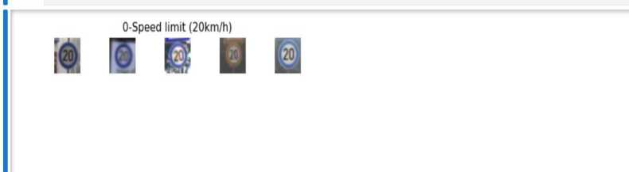
APPENDIX:
SOME TRAINING OUTPUTS
DATA VISUALIZAION
1500
0 10 20 30 40
Class number
13

Slide 7
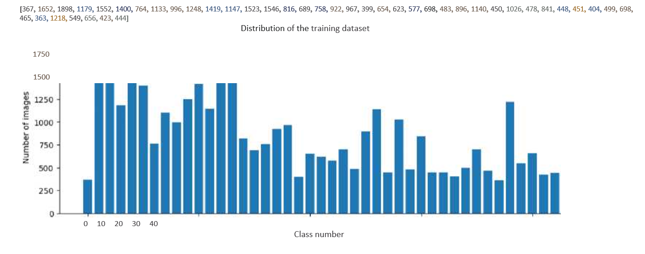
APPENDIX:
2. DATA DISTRIBUTION
1500
0 10 20 30 40
Class number
13

Slide 8
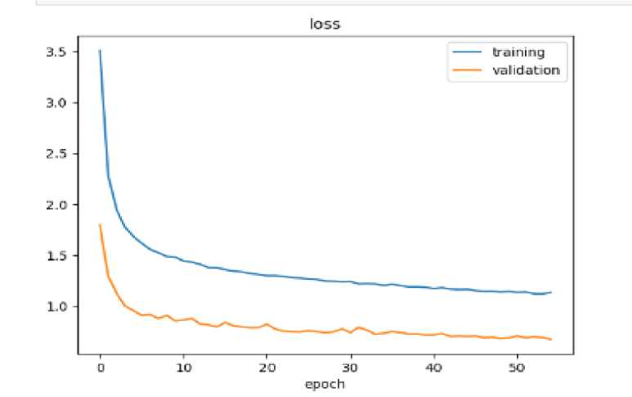
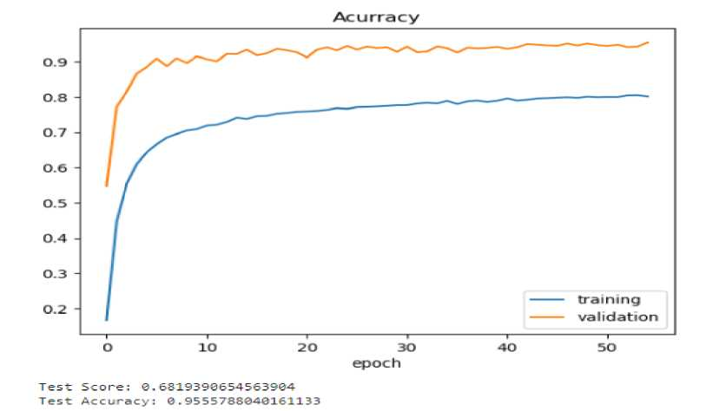
APPENDIX:
3. DATA AUGMENTATION AND VISUALISING USING KERAS
4. MODEL EVALUATION AND VIISUALIZATION OF TRAINING METRICS
1500
0 10 20 30 40
Class number
13

Slide 9
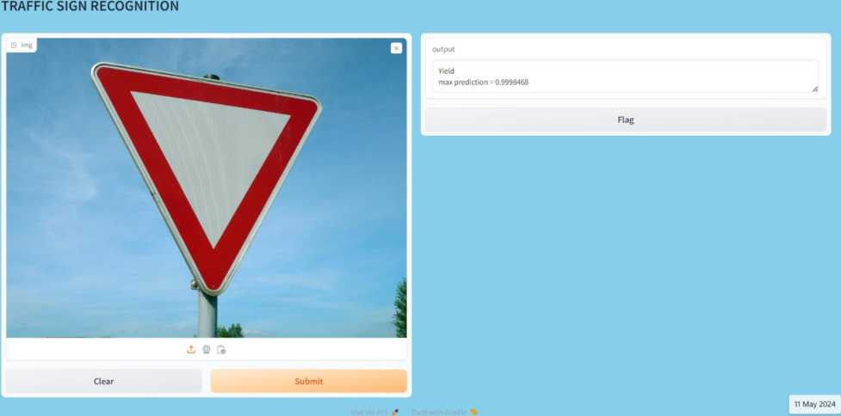
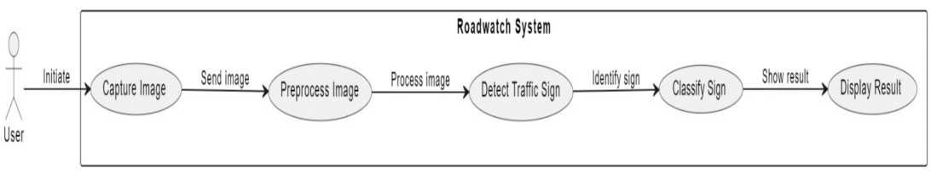
APPENDIX:
5. WORKING SCREENSHOTS OF THE INTERFACE WITH OUTPUTS: -
6. USE CASE DIAGRAM [BASIC FLOW] :
1500
0 10 20 30 40
Class number
13

Slide 10
ADVANTAGES:
1.Enhanced Road Safety: A proficiently trained road sign classification model enables accurate recognition and interpretation of traffic signs, contributing to improved road safety by aiding drivers in comprehending road conditions effectively.
2.Minimized Human Error: Human drivers often encounter errors such as overlooking or misinterpreting traffic signs. The integration of a machine learning model can mitigate such errors, thereby enhancing overall road safety.
3.Enhanced Efficiency: By precisely identifying traffic signs, a machine learning model facilitates the reduction of traffic congestion and promotes traffic flow optimization, leading to increased efficiency on roadways.
4.Cost-effectiveness: The adoption of a machine learning model for road sign classification can prove cost-effective over time. It diminishes reliance on human resources and enhances transportation system efficiency, yielding long-term economic benefits.
5.Scalability: Machine learning models possess inherent scalability, allowing them to manage substantial volumes of data seamlessly. This attribute makes them suitable for integration into smart city applications and large-scale transportation systems.
6. Real-time Responsiveness: A well-crafted machine learning model offers real-time responses to dynamic road conditions. This capability aids in promptly addressing changes, thereby bolstering safety and efficiency on roadways.
7.Improved Accuracy: Advancements in machine learning algorithms and techniques enable road sign classification models to attain high levels of accuracy. This reliability fosters trust in transportation systems, ensuring their effectiveness and dependability.

Slide 11
LIMITATIONS:
1.Limited Training Data: Insufficient diversity in the training dataset can hinder the ML model's ability to accurately recognize various road signs or situations, resulting in reduced accuracy and difficulty in identifying certain signs.
2.Environmental Factors: Variations in lighting conditions, occlusions, and weather conditions pose challenges for the ML model's recognition accuracy. Inadequate handling of these environmental factors can lead to inaccuracies in road sign recognition.
3. Hardware Limitations: The hardware infrastructure used to execute the ML model may lack sufficient processing power for real-time image processing. This can result in slower processing speeds, impacting the model's accuracy and responsiveness.
4.Model Complexity: Complex ML models may demand significant computational resources, leading to slow inference times and increased energy consumption. Managing the trade-off between model complexity and efficiency is crucial for maintaining optimal performance.
5.Generalization: ML models may struggle to generalize to different types of road signs, increasing the risk of misclassification and inaccurate recognition. Enhancing the model's ability to generalize across diverse scenarios is essential for robust performance.
6.Human Error: Challenges such as misaligned or damaged road signs can introduce errors in the recognition process. ML models may struggle to handle such instances of human error, potentially leading to incorrect classification.

Slide 12
CONCLUSION:
In conclusion, the implementation of a Machine Learning (ML) model for Road Sign Classification, capable of identifying road signs based on uploaded images, represents a valuable application of machine learning techniques. This model employs deep learning algorithms such as Convolutional Neural Networks (CNNs) to learn and classify various road signs effectively.
By submitting an image of a road sign, the ML model can accurately categorize the sign and provide pertinent information regarding its meaning and significance. This functionality proves advantageous in numerous scenarios, particularly when navigating unfamiliar areas or countries where road signs may be unfamiliar.
However, the efficacy of the model is contingent upon several factors, including the quality of the input image, the comprehensiveness of the training dataset, and the complexity of the model architecture. Hence, it is imperative to ensure that the model undergoes training on a diverse dataset encompassing various road signs and is subjected to rigorous testing across different scenarios to enhance its accuracy and dependability.
In summary, the Road Sign Classification ML model has the potential to enhance road safety and convenience by furnishing prompt and accurate information about road signs. Nonetheless, continuous refinement and updates are essential to accommodate evolving road sign designs and uphold the model's efficacy in real-world applications.

Slide 13
FUTURE APPLICATIONS:
1. Improved Model Accuracy: There is considerable potential for refining the ML model to attain higher accuracy levels and robustness in road sign classification. This can be achieved through innovative approaches in deep learning architectures, data augmentation methodologies, and the exploration of transfer learning techniques tailored to the specific domain of road sign recognition.
2. Real-time Performance Enhancement: Future advancements may concentrate on optimizing the ML model for real-time performance, enabling swift inference on resource-constrained devices like smartphones and embedded systems. Strategies such as model compression, hardware acceleration, and algorithmic optimizations are avenues worth exploring for achieving this objective.
3. Adaptation to Dynamic Environments: Further research efforts could focus on enhancing the ML model's adaptability to dynamic environmental conditions, including variations in lighting, weather, and road surface conditions. Techniques such as domain adaptation and continual learning hold promise for improving the model's generalization capabilities across diverse scenarios.
4. Multi-modal Integration: Integrating additional sensor modalities, such as LIDAR and radar, alongside visual data from cameras, can provide complementary information for robust road sign detection and classification. Fusion of multi-modal data streams presents an opportunity to enhance the model's performance in challenging conditions and increase overall reliability.

Slide 14
FUTURE APPLICATIONS:
5. Localization and Mapping: Expanding the model's functionality to include simultaneous localization and mapping (SLAM) techniques can facilitate accurate localization of detected road signs within the surrounding environment. This capability is essential for applications like autonomous driving and augmented reality navigation systems.
6. Semantic Understanding of Road Scenes: Advancements in semantic segmentation and scene understanding can enable the ML model to grasp the context of road scenes beyond individual road signs. Analyzing the placement context of road signs and their interactions with other objects can provide more nuanced insights for drivers and enhance overall road safety.
7. Continual Learning and Adaptation: Implementing mechanisms for continual learning and adaptation will enable the ML model to evolve over time and adapt to changing road sign designs, regulations, and environmental conditions. This ensures the model remains effective and relevant in the long term, even as road infrastructures evolve.
8. Deployment in Smart Cities: Extending the deployment of road sign classification models to smart city infrastructure can facilitate proactive traffic management and enhanced safety measures. Integration with traffic control systems, autonomous vehicles, and urban planning initiatives can lead to more efficient and sustainable transportation systems.

Slide 15
BIBLOGRAPHY:
1.GeeksforGeeks (2022) Traffic signs recognition using CNN and Keras in python, GeeksforGeeks. Available at: https://www.geeksforgeeks.org/traffic-signs-recognition-using-cnn-and-keras-in-python/ (Accessed: 11 May 2024).
2. Hemateja, A.V.N.M. (2021) Traffic sign dataset - classification, Kaggle. Available at: https://www.kaggle.com/datasets/ahemateja19bec1025/traffic-sign-dataset-classification (Accessed: 11 May 2024).
3.Where developers learn, share, & build careers (no date) Stack Overflow. Available at: https://stackoverflow.com/ (Accessed: 11 May 2024).
4."Traffic Sign Classification with Keras and Deep Learning" by Adrian Rosebrock (2018)
-This tutorial provides a step-by-step guide to building a traffic sign classification model using Keras and deep learning. It covers data preprocessing, model training, and evaluation using the GTSRB dataset.
5."A Comprehensive Guide to Convolutional Neural Networks — the ELI5 way" by Sumit Saha (2021)
- This article provides an easy-to-understand explanation of convolutional neural networks (CNNs), which are commonly used in image classification tasks. It covers the basic concepts of CNNs, such as 26 convolution, pooling, and activation functions, and provides some examples of how they can be used for image classification.

Slide 16
BIBLOGRAPHY:
6.Traffic Sign Recognition with Multi-Scale Convolutional Networks" by Pierre Sermanet and Yann LeCun (2011)
-This research paper introduced a deep learning approach for traffic sign recognition using convolutional neural networks (CNNs). It provides a good overview of the architecture and training process of the model.
7.German Traffic Sign Recognition Benchmark" by J. Stallkamp, M. Schlipsing, J. Salmen, and C. Igel (2012)
-This paper introduces the German Traffic Sign Recognition Benchmark (GTSRB), a large dataset of traffic sign images for benchmarking machine learning models. The authors also provide an overview of the state-ofthe-art methods for traffic sign recognition at the time.
8."Image Classification using Transfer Learning in PyTorch" by Sasank Chilamkurthy (2018)
-This tutorial provides a guide to building an image classification model using transfer learning in PyTorch. It covers the basic concepts of transfer learning and provides an example of how to use a pre-trained CNN model for traffic sign classification.

